Slide 1
Unit II – Leadership Skills
Chapter 1 - Followership
Section 1 – The Importance of Good Followership

Slide 2
Learn to become a better leader by becoming a better follower

Slide 3
Explain the importance of good followership
Describe the readiness factors of followers
Explain how to build productive relationships with leaders
Describe how to be an effective follower

Slide 4
Key Term Questions Slide Index
Click any link below to go directly to polling that question.
Help a leader succeed at leading
Prepared to carry out tasks
Experience, skill brought to a task
Motivation to accomplish a task
Self-assurance
Taking the initiative
Click here to return to this index.

Slide 5
Team Assignment
Alpha
Bravo
Charlie
Delta

Slide 6
Displaying the attitudes, behaviors and actions that help a leader succeed at leading
Followership
Willingness
Readiness
Ability
1
1
1
1
(NS1-U2C1S1:KT1)

Slide 7
How prepared a team member is to carry out a particular task or tasks
Proactive
Willingness
Readiness
Ability
1
1
1
1
(NS1-U2C1S1:KT2)

Slide 8
The knowledge, experience and skill of a team member or a team brings to a task
Followership
Willingness
Readiness
Ability
1
1
1
1
(NS1-U2C1S1:KT3)

Slide 9
The degree to which a team member or a team shows confidence, commitment and motivation to accomplish a task
Followership
Willingness
Readiness
Ability
1
1
1
1
(NS1-U2C1S1:KT4)

Slide 10
Faith or belief that a person will act in a right, proper or effective way; self-assurance
Proactive
Confidence
Readiness
Ability
1
1
1
1
(NS1-U2C1S1:KT5)

Slide 11
Taking the initiative and assuming part of the responsibility to make things happen
Proactive
Willingness
Readiness
Ability
1
1
1
1
(NS1-U2C1S1:KT6)

Slide 12
Key Terms
Followership -
Displaying the attitudes, behaviors
and actions that help a leader
succeed at leading
Readiness -
How prepared a team member is to
carry out a particular task or tasks
Ability -
The knowledge, experience and skill
of a team member or a team brings
to a task

Slide 13
Key Terms
Willingness -
The degree to which a team member
or a team shows confidence,
commitment and motivation to
accomplish a task
Confidence -
Faith or belief that a person will act
in a right, proper or effective way;
self-assurance
Proactive -
Taking the initiative and assuming
part of the responsibility to make
things happen

Slide 14
List 2-3 qualities of a good follower.
1.
2.
3.
Note to Instructors:
Click the Show/Hide Response Display Button

Slide 15
Are you better at leading or following?
I am a better leader than a follower.
I am a better follower than a leader.
I am pretty good at both leading and following.
I am not very good (yet) at either leading or following; need some practice.
1
1
1
1
(NS1-U2C1S1:LQ1)

Slide 16
The qualities that make a good leader are very different than the qualities that make a good follower.
True
False
(NS1-U2C1S1:LQ2)

Slide 17
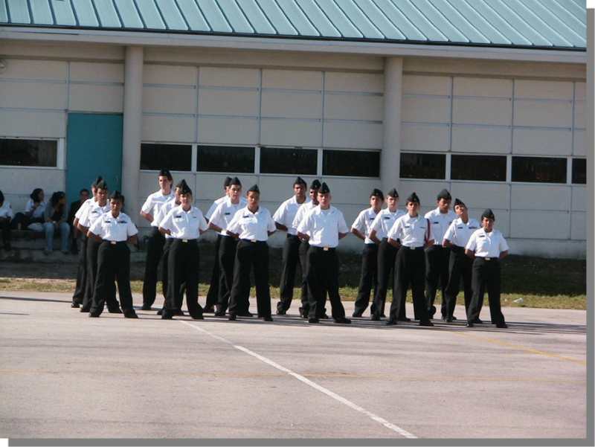
The Importance of Good Followers
Good leaders emerge from the ranks of good followers.
In an effective group, the followers are more than just blindly doing as they are told.
They are the “heart and soul” of a great team.

Slide 18
The Importance of Good Followers
Even the President finds himself in both follower and leader roles at different times.
But the president reports to (follows) Congress and the American people.
Secretary of the Navy
The roles of leader and follower apply to everyone at different times, including the President.
These people report to (follow) the president.

Slide 19
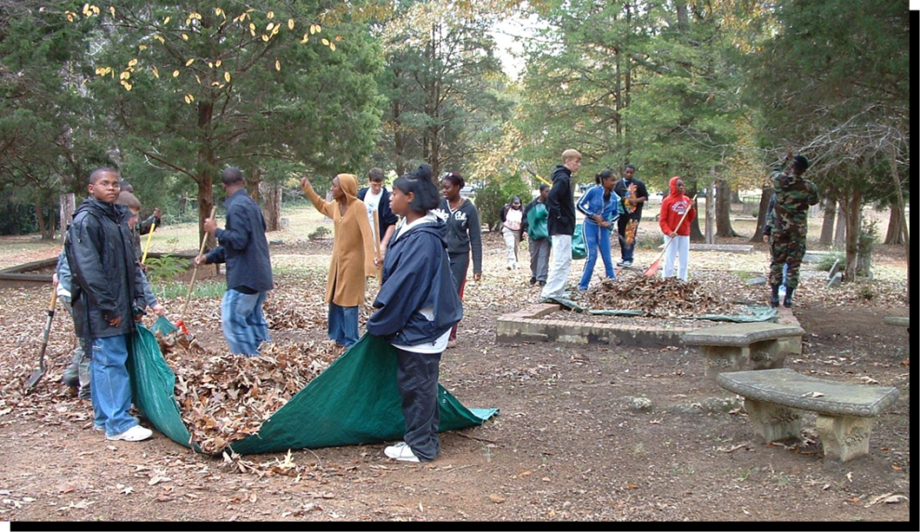
The Importance of Good Followers
Think of some examples where you are a leader sometimes, and a follower sometimes…
At school
At home
Among your friends
In your NJROTC Unit

Slide 20
Qualities of Followers and Leaders
Good Leaders
Since there is overlap between the skills of good followers and good leaders, moving between roles is possible as needed.
Inspiring
Cooperative
Honest
Good Followers
Competent
Forward-
thinking
Dependable

Slide 21
Types of Followers
Dependent: A “yes-man” or “yes-woman” waits to be told what to do; does not take initiative on own
Independent but alienated: Capable of working on own, but not engaged and seems not to care very much
Independent and effective: Dependable to work well and motivated to do so
Which type would tend to be the most positive and productive team member?

Slide 22
Which type of follower would be most effective on a team?
Dependent
Independent but alienated
Independent and effective
1
1
1
(NS1-U2C1S1:LQ3)

Slide 23
Some qualities are more important for leaders, some for followers, and some that apply equally to both. Of the qualities listed below, which apply equally to both leaders and followers? (Input all that apply; then push the ENTER button.)
Inspiring
Forward-thinking
Honest
Competent
1
1
1
1
(NS1-U2C1S1:LQ4)

Slide 24
Power of the Follower
Each follower is important and has individual attributes to contribute to the team, such as:
Unique individual skills and experience
Unique personality
Potential ability to change the group’s behavior
The roles of leader and follower apply to everyone at different times, including the President.
A skilled team leader decides how to use each individual’s skills to the greatest benefit of the team.

Slide 25
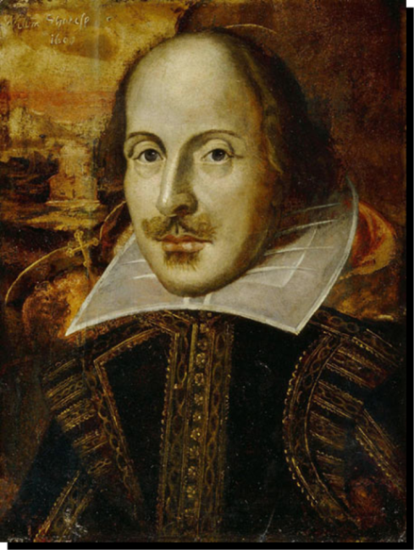
Readiness Factors of Followers
Understanding follower readiness is a key element of leadership.
Readiness level =
ability + willingness + confidence
A good leader helps team members gain knowledge or skill to perform at their highest level.
Shakespeare’s character
Hamlet said,
“The readiness is all.”
The roles of leader and follower apply to everyone at different times, including the President.

Slide 26
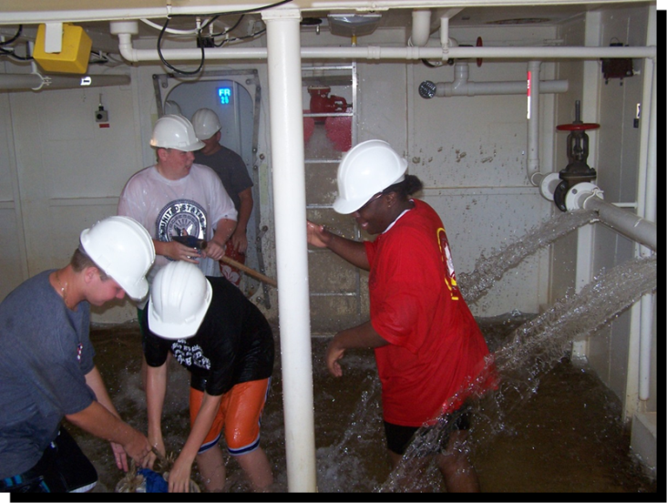
Readiness Factors of Followers
Ability and willingness affect each other. A change in either factor will affect the way the two factors operate together.
And, as team members’ competence and abilities change, so will their attitudes, levels of enthusiasm and ___________.
commitment

Slide 27
Readiness Factors of Followers
A boost in confidence usually results when an individual becomes more competent at a skill or skill set.
Good leaders notice these changes in their followers.
If the follower experiences failure when trying new things, it’s important to avoid labeling them, and give them other ___________ to grow and succeed.
opportunities

Slide 28
Follower Readiness Levels
Level 1 – Lacks ability, commitment and motivation
 |  | Readiness Level 1 | Readiness Level 2 | Readiness Level 3 | Readiness Level 4
Ability | Unable | X | X
 | Able |  |  | X | X
Willingness | Not Willing | X |  | X
 | Willing |  | X |  | X
Level 2 – Motivated and makes effort, but lacks ability

Slide 29
Follower Readiness Levels
Level 3 – Can, but doesn’t want to, or is insecure about ability
 |  | Readiness Level 1 | Readiness Level 2 | Readiness Level 3 | Readiness Level 4
Ability | Unable | X | X
 | Able |  |  | X | X
Willingness | Not Willing | X |  | X
 | Willing |  | X |  | X
Level 4 – Has ability, commitment and confidence

Slide 30
Shakespeare's character Hamlet said, ________ is all.
Attitude
Confidence
Training
Readiness
1
1
1
1
(NS1-U2C1S1:LQ5)

Slide 31
Readiness level = ________ + ________ + ________. (Input all that apply; then push the ENTER button.)
Ability
Height
Willingness
Age
Confidence
1
1
1
1
1
(NS1-U2C1S1:LQ6)

Slide 32
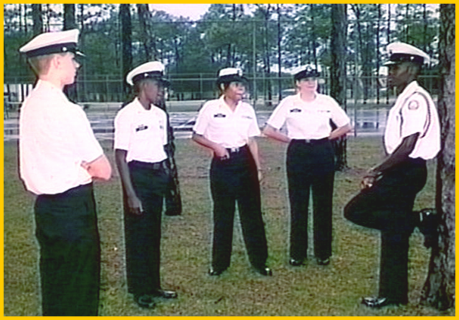
Building Effective Relationships with Leaders
The relationship between leader and follower may start off as good, bad or somewhere in-between… but can be strengthened with effort on both sides.
The roles of leader and follower apply to everyone at different times, including the President.

Slide 33
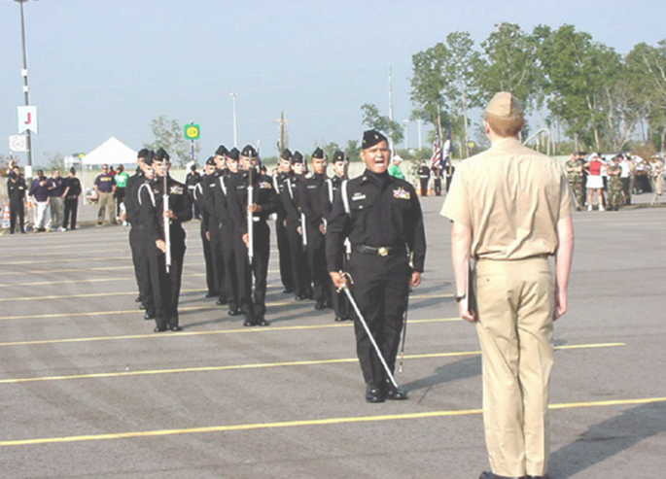
Building Effective Relationships with Leaders
A follower can strengthen the leader-follower relationship by doing these things:
Always help the leader succeed
Understand the leader’s world
Educate your leader
Keep your leader informed (no surprises!)
Adapt to your leader’s style
The roles of leader and follower apply to everyone at different times, including the President.

Slide 34
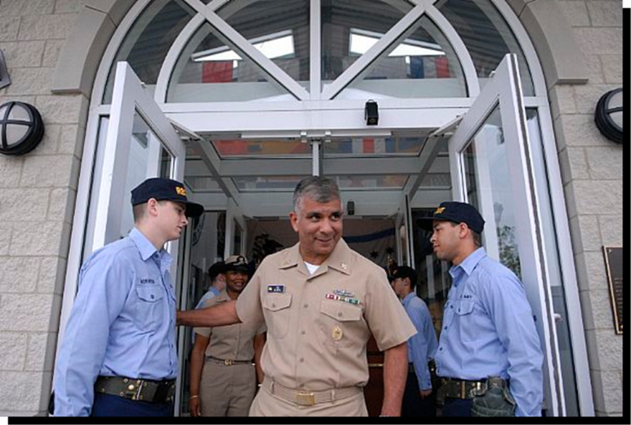
Building Effective Relationships with Leaders
New leaders usually need team members’ help as they may not have the specific knowledge about the team, to organize it to achieve its greatest potential.
As a good follower, you
should always step up to
make sure this support for
your leader happens.
The roles of leader and follower apply to everyone at different times, including the President.

Slide 35
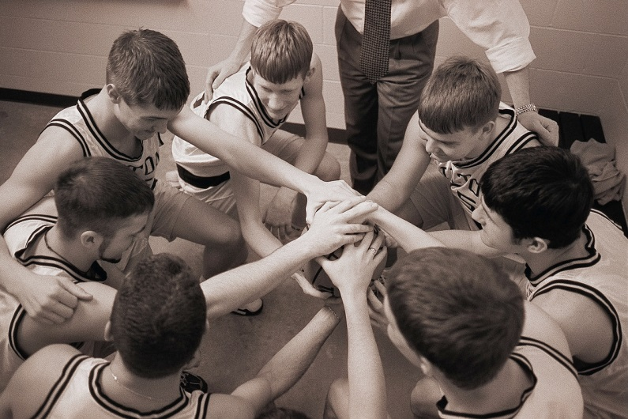
Building Effective Relationships with Leaders
After a supportive relationship is in place between a leader and a follower, you can take additional actions to be an effective follower, such as:
Being honest
Not griping
Being proactive
Making sound decisions
Being enthusiastic, with contagious energy
Being versatile and flexible

Slide 36
Conclusions
As a follower, you can learn a lot about effective leadership by watching good leaders in action.
Good leaders and good followers have similar skill sets.
The leader’s job is to help his or her followers succeed; and in turn the follower’s job is to help their leader succeed.
The shared goal is to be part of an excellent team!

Slide 37
If the relationship between you and a leader starts off badly, it typically will remain bad no matter what either one does. First impressions are pretty solid.
True
False
(NS1-U2C1S1:LQ7)

Slide 38
Which of the following statements is true? (Input all that apply; then push the ENTER button.)
New leaders usually do not want help from their team. They need time to establish their own authority.
New leaders need team members help as they may not have the specific knowledge about the team.
You should step back with new leaders and let them figure things out own their own.
You should step up with new leaders and make sure they have the support they need.
1
1
1
1
(NS1-U2C1S1:LQ8)

Slide 39
Explain why it would be important for the followers to adapt to the leader’s style.
1.
2.
3.
Note to Instructors:
Click the Show/Hide Response Display Button

Slide 41
Leaderboard
Last
Slide
Points | Participant | Points | Participant

Slide 42
Team Scores
Last
Slide
Points | Team | Points | Team

Slide 43
Team MVP
Last
Slide
Points | Team | Participant

Slide 44
Whiteboard
Last
Slide

